Slide 1
2024 LEAP TESTING INFORMATION

Slide 2
LEAP Testing Dates: April 15-May 3
•April 15-17: 7th math and ELA sessions 1-3
•April 18-19, 22: 6th math and ELA sessions 1-3
•April 23-25: 8th math and ELA sessions 1-3
•April 26, 29: 7th social studies and science
•April 30, May 1: 6th social studies and science
•May 2-3: 8th social studies and science
May 7-9: Algebra EOC testing

Slide 3
6th Grade LEAP Test Dates
April 18-19, 22: 6th math and ELA sessions 1-3
April 30, May 1: 6th social studies and science

Slide 4
7th Grade LEAP Test Dates
April 15-17: 7th math and ELA sessions 1-3
April 26, 29: 7th social studies and science

Slide 5
8th Grade LEAP Test Dates
April 23-25: 8th math and ELA sessions 1-3
May 2-3: 8th social studies and science

Slide 6
Algebra Testing Dates
May 7-9: Algebra sessions 1-3

Slide 7
WHAT TO EXPECT FOR EACH SUBJECT AREA

Slide 8
TESTING DAY 1
ELA Session 1: 90 minutes
Math Session 1: 60 minutes (no calculator)

Slide 9
TESTING DAY 2
ELA Session 2: 90 minutes
Math Sessions 2: 90 minutes

Slide 10
TESTING DAY 3
ELA Session 3: 80 minutes
Math Session 3: 80 minutes (calculator)

Slide 11
ELA Sessions Overview
Session 1 (90): Literary Analysis Task and a passage set with one text OR Research Simulation Task
Session 2 (90): Research Simulation Task OR Narrative Writing Task and a passage set with one text or a pair of related texts
Session 3 (80): Reading Literary/Informational Texts

Slide 12
MATH Sessions Overview
3 sessions at-a-glance:
Session 1: (60, no calculator): Type I tasks
Session 2: (90, calculator): Mix of Type I, Type II, Type III tasks
Session 3: (80, calculator): Mix of Type I, Type II, Type III tasks

Slide 13
Math Type I, II, and III Questions
Type I questions: designed to assess conceptual understanding, fluency, and application, are aligned to the major content specified for each grade and additional and supporting content.
Type II questions: Type II tasks are designed to assess student reasoning ability with the major content for the current grade level or previous grade level.
Type III questions: Type III tasks are designed to assess student modeling ability with specified content of the current grade level or previous grade level.

Slide 14
Type I example (1)

Slide 15
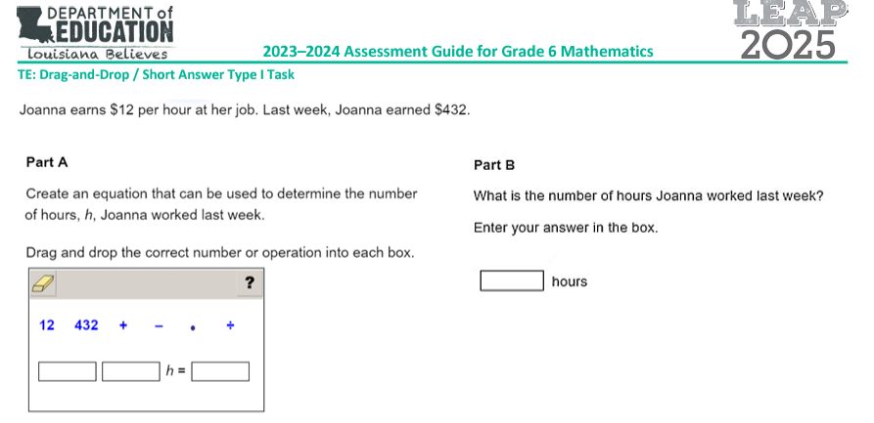
Type I Example (2)

Slide 16
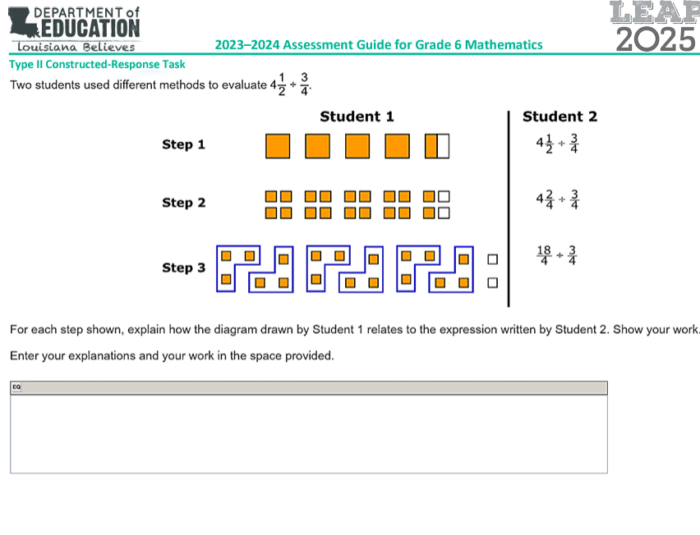
Type II Item Example

Slide 17
Type III Item Example

Slide 18
ALGEBRA: May 7-9
Day 1 (May 7)
Session 1a: 25 minutes
Session 1b: 55 minutes
Day 2 (May 8)
Session 2: 90 minutes
Day 3 (May 9)
Session 3: 75 minutes

Slide 19
Testing Day 4: SCIENCE
Session 1: 90 minutes
Session 2: 90 minutes
7th and 8th only:
Session 3: 45 minutes

Slide 20
Science Sessions Overview
Session 1: (90)
3 Item Sets
6 Standalone items
Session 2: (90)
Task
2 Item Sets
Session 3: (45, 7th and 8th graders only)
5 Item Sets
1 Task
12 Standalones

Slide 21
Science Questions Types
Item sets, task sets, and standalone items
A scientific phenomenon provides the anchor for each set or standalone item.
Stimulus materials: include maps, charts, data tables, bar graphs, etc. related to the scientific phenomenon provide context and focus for sets. culminates with an extended-response item.

Slide 22
Testing Day 5: SOCIAL STUDIES
Session 1: 70 minutes
Sessions 2a and 2b: 35 minutes each (70 total)
Session 3: 70 minutes

Slide 23
Social Studies Sessions Overview
The social studies test will be new this year, but it will include:
Primary documents to read
Written responses to the documents analyzing, comparing and contrasting, responding
Using context and making connections with the social studies knowledge students have learned this year.

Slide 24
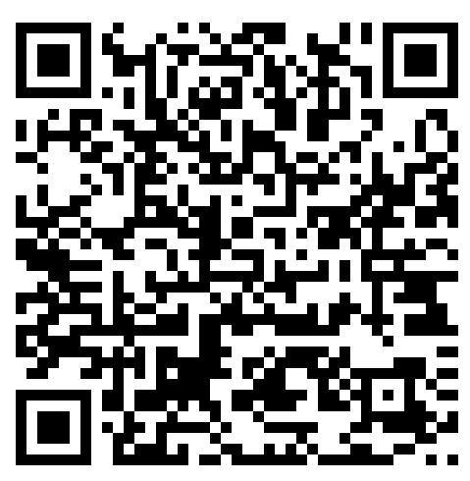
Louisiana Believes LEAP Test Link
https://www.louisianabelieves.com/resources/library/assessment-guidance

Slide 25
Preparing Your Student for the LEAP Test

Slide 26
LEAP Test Assessment Guides
In-depth overview of the LEAP test for each subject area including example questions.
Talk through this guide with your student so that they will know what to expect on each test.
Teachers have been and will also prepare student with this information, but hearing it from mom and dad will reinforce this.

Slide 27
Louisiana Believes LEAP Test Link
https://www.louisianabelieves.com/resources/library/assessment-guidance

Slide 28
SLEEP WELL
A good night’s sleep helps brains and bodies function much better.
Recommended Requirements by age:
12 years: 9.25 Hours
13 years old: 9.25 Hours
14 years old: 9 hours

Slide 29
SCREENS AT NIGHT
Using screens at night can cause restlessness and interrupted sleep cycles.
Light from screens disrupts the release of melatonin which is the chemical that helps you sleep.
Rutger University study: Students who used screens right before bed or during the night performed worse on tests.
Solution: Turn off devices and hour before bed.

Slide 30
EAT WELL
Protein, fat, complex carbs (non processed) foods are best for long-lasting fuel for a day of testing: eggs, meat, dairy, nuts, whole-grains

Slide 31
BE ON TIME EVERY TESTING DAY
Tardy students may not enter a testing room until a session is complete.

Slide 32
DURING TESTING AND TEST TAKING STRATEGIES

Slide 33
DURING TESTING
Teachers cannot help students with test.
Teachers will let students know when time is almost up.
Tardy students cannot enter testing class until session is over.
Students cannot go back to a previous session or test.

Slide 34
THINK POSITIVELY
Studies show that students who tell themselves, “I will do well. I am prepared. I know these things,” perform better on tests.
Parental encouragement is also a big predictor of student test achievement.

Slide 35
FOLLOW DIRECTIONS
Read directions carefully so that you do not miss part of a question and lose points. Especially for
Writing tasks
Multi-part questions

Slide 36
PRETEND YOU ARE ALONE.
Block out other students.
Do not worry about whether other students seem to be finishing faster, are taking bathroom breaks, or asking the testing teacher for help.
Students who take most or all of the time limits to test usually test higher that fast finishers.

Slide 37
PACE YOURSELF
If you get stuck on a question, skip it an come back!
When you get done with all questions, GO BACK OVER THEM IF YOU STILL HAVE TIME.

Slide 38
FLAG QUESTIONS AND COME BACK INSTEAD OF CHANGING ANSWERS MULTIPLE TIMES
Tests that have many changes to questions (especially wrong to right) are red-flagged by the state for review.

Slide 39
NARROW DOWN CHOICES
Cross out the most obvious wrong choices and focus only on the answers that seem to be right.
Usually there will be 1-2 answers that are obviously wrong and 1 answer that is very close to correct.

Slide 40
USE SCRATCH PAPER
Work out math answers on your scratch paper.
Make a brief outline for any writing task.

Slide 41
The LEAP test is a demanding test that requires the right attitude and work ethic to do well on it. WAJH students have the ability to excel on the LEAP test! Please encourage your students to do their best.

